Slide 1
Routing Protocols

Slide 2
Routing protocols
Routing protocol is used to determine how routing is performed within an autonomous system (AS). Intra-AS routing protocols are also known as interior gateway protocols.
The common Routing protocols are:
  Routing Information Protocol (RIP).
  Open Shortest Path First (OSPF).
  Border Gateway Protocol (BGP).

Slide 3
Broadcast and Multicast Routing
broadcast routing, the network layer provides a service of delivering a packet sent from a source node to all other nodes in the network.
multicast routing enables a single source node to send a copy of a packet to a subset of the other network nodes.

Slide 4
Broadcast Routing Algorithms
The sending node to send a separate copy of the packet to each destination.
Given N destination nodes, the source node simply makes N copies of the packet, addresses each copy to a different destination, and then transmits the N copies to the N destinations using unicast routing.
This is called N-way-unicast approach to broadcasting packets.

Slide 5
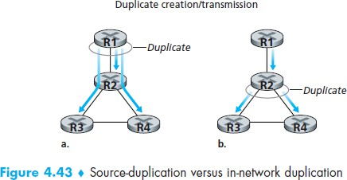
Broadcast Routing Algorithms

Slide 6
Flooding
The most obvious and popular technique for achieving broadcast is a flooding approach.
There are two types of flooding:
  Uncontrolled Flooding
  Controlled Flooding

Slide 7
Uncontrolled Flooding
The source node sends a copy of the packet to all of its neighbours.
When a node receives a broadcast packet, it duplicates the packet and forwards it to all of its neighbours (except the neighbour from which it received the packet).

Slide 8
Uncontrolled Flooding
Problems:
  If the graph has cycles, then one or more copies of each broadcast packet will cycle indefinitely.
  When a node is connected to more than two other nodes, it will create and forward multiple copies of the broadcast packet, each of which will create multiple copies of itself (at other nodes with more than two neighbours), and so on.
  This is called broadcast storm, resulting from the endless multiplication of broadcast packets, would eventually result in so many broadcast packets being created that the network would be rendered useless.

Slide 9
Controlled Flooding
To avoiding a broadcast storm problem uses controlled flooding approach.
A node to judiciously choose when to flood a packet and (e.g., if it has already received and flooded an earlier copy of a packet) when not to flood a packet.
Two approaches:
sequence-number-controlled flooding
reverse path forwarding (RPF) or reverse path broadcast (RPB)

Slide 10
Controlled Flooding
In sequence-number-controlled flooding, a source node puts its address (or other unique identifier) as well as a broadcast sequence number into a broadcast packet, then sends the packet to all of its neighbours.
Each node maintains a list of the source address and sequence number of each broadcast packet it has already received, duplicated, and forwarded.

Slide 11
Controlled Flooding
When a node receives a broadcast packet, it first checks whether the packet is in this list. If so, the packet is dropped; if not, the packet is duplicated and forwarded to all the node’s neighbours (except the node from which the packet has just been received).

Slide 12
Controlled Flooding
A second approach to controlled flooding is known as reverse path forwarding (RPF) [Dalal 1978], also sometimes referred to as reverse path broadcast (RPB).
When a router receives a broadcast packet with a given source address, it transmits the packet on all of its outgoing links (except the one on which it was received) only if the packet arrived on the link that is on its own shortest unicast path back to the source.

Slide 13
Controlled Flooding
Otherwise, the router simply discards the incoming packet without forwarding it on any of its outgoing links. Such a packet can be dropped because the router knows it either will receive or has already received a copy of this packet on the link that is on its own shortest path back to the sender.

Slide 14
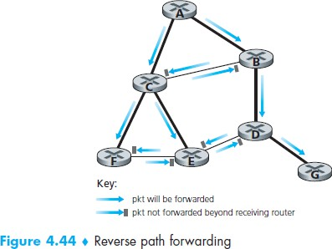
Controlled Flooding

Slide 15
The Distance-Vector (DV) Routing Algorithm
The distance vector (DV) algorithm is iterative, asynchronous, and distributed.
  It is distributed in that each node receives some information from one or more of its directly attached neighbours, performs a calculation, and then distributes the results of its calculation back to its neighbours.
  It is iterative in that this process continues on until no more information is exchanged between neighbours.
  The algorithm is asynchronous in that it does not require all of the nodes to operate in lockstep with each other.

Slide 16
The Distance-Vector (DV) Routing Algorithm
Let dx(y) be the cost of the least-cost path from node x to node y. Then the least costs are related by the celebrated Bellman-Ford equation, namely,
where the min_{v} in the equation is taken over all of x’s neighbours. After traveling from x to v, if we then take the least-cost path from v to y, the path cost will be c(x,v) + d_{v}(y).

Slide 17
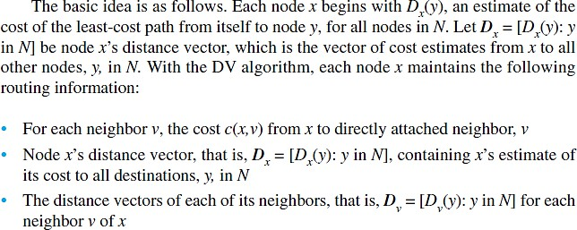
The Distance-Vector (DV) Routing Algorithm

Slide 18
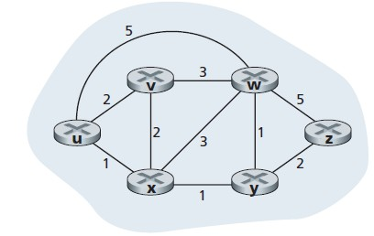
The source node u has three neighbours: nodes v, x, and w.
d_{u}(z) = min{c(u,v)+d_{v}(z), c(u,x)+d_{x}(z), c(u,w)+d_{w}(z)}
d_{u}(z) = min{2 + 5, 1 + 3, 5 + 3} = 4,

Slide 19
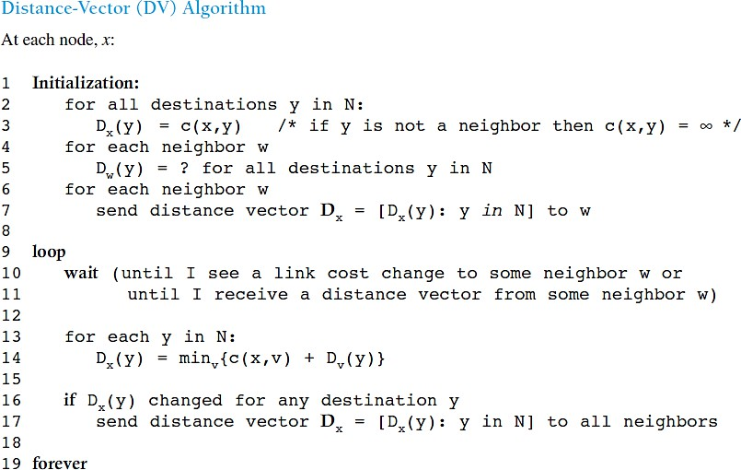

Slide 20


The Distance-Vector (DV) Routing Algorithm

Slide 21
Link-state routing
Link-state routing is a dynamic routing protocol where each router creates a complete map of the network by exchanging its local link information with all other routers.
Routers flood Link State Advertisements (LSAs) to build a link-state database (LSDB).
Each router then independently uses the LSDB to run an algorithm, typically Dijkstra's algorithm, to calculate the shortest path to all other destinations

Slide 22
How it works
Neighbor Discovery:
Routers use "hello" packets to discover directly connected neighbors and their associated costs.
LSA Creation:
Each router creates a Link State Advertisement (LSA) containing information about its neighbors, the cost of the links, and a sequence number to identify the most recent packet.
LSA Flooding:
LSAs are flooded throughout the network, meaning each router sends its LSA to all other routers, ensuring every router has a copy of the same network topology data.

Slide 23
LSDB Construction:
Routers use the received LSAs to build and maintain a Link-State Database (LSDB), which is essentially a complete map of the network.
Shortest Path Calculation:
Each router independently runs Dijkstra's algorithm on its LSDB to calculate the shortest path to every other router.
Routing Table Update:
The results of the Dijkstra algorithm are used to populate the routing table, directing traffic along the most efficient paths.

Slide 24
END

